Slide 1
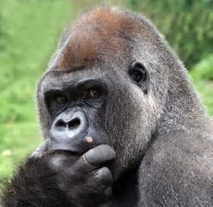
apeglm: Shrinkage Estimators for Differential Expression of RNA-Seq
Anqi Zhu, Joseph G. Ibrahim, Michael I. Love
Department of Biostatistics,
Gillings School of Public Health,
University of North Carolina Chapel Hill

Slide 2
apeglm:
  Shrinkage estimator on Generalized Linear Model (GLM) coefficients
  Workflow:
  apeglm(Y, x, log.lik, param=NULL, coef=NULL, …)
Count matrix, design matrix,
likelihood function, nuisance parameters
Input
apeglm
Shrinkage estimator and Standard Error,
False Sign Rate and s value, Stephens 2016
Credible intervals
Downstream analysis

Slide 3
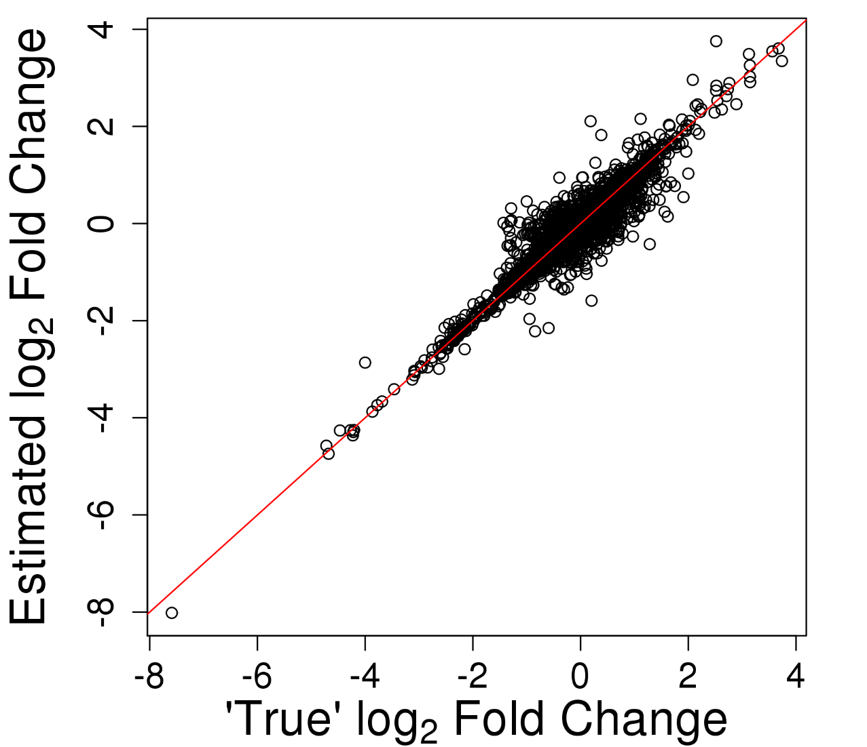
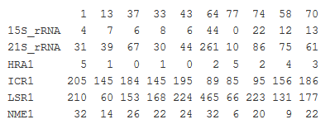
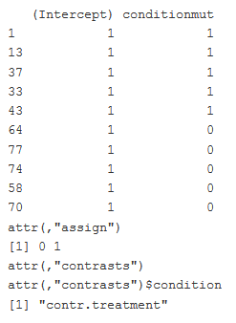
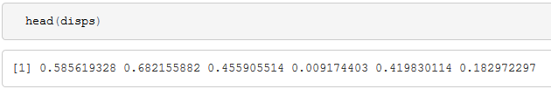
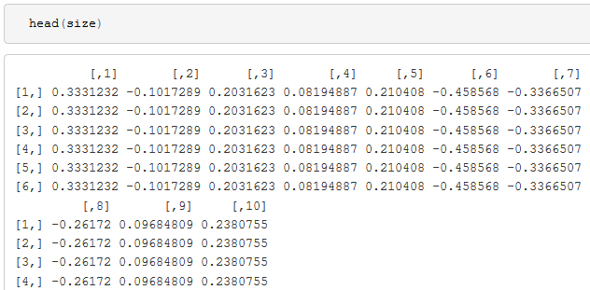
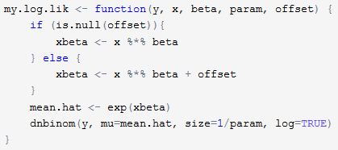
Example: Differential Expression Analysis of RNA-Seq
Nuisance Parameter
Count Matrix
Design matrix
Likelihood function
Figure: Estimates over true LFCs.
Notes:
Detect genes with changes in expression level across different experimental conditions

Slide 4
Other features of apeglm
Contrasts
Weights
Random nuisance parameter
Other type of High Throughput Sequencing data
Available at
  https://bitbucket.org/azhu513/apeglm
  DESeq2::lfcshrink() (after submitting to Bioconductor)

Slide 5
Reference
Love, Michael I., Wolfgang Huber, and Simon Anders. "Moderated estimation of fold change and dispersion for RNA-seq data with DESeq2." Genome biology 15.12 (2014): 550.
Stephens, Matthew. "False discovery rates: a new deal." Biostatistics 18.2 (2016): 275-294.

